Slide 1
Fun with Mapping!

Slide 2
Map Scale:
Scale will either be written in one of two ways:
representative fraction: ie: 1: 50 000
Scale written as 1:100 000 means that 1cm on the map = 100 000 centimeters in real life.
Since 100 000cm = 1km we know that 1cm=1km real life
The most common RF scales are 1:25 000, 1:50 000, and 1:100 000
linear scale: where there is a ruler on the bottom of the map.

Slide 3
Determining Scale
If we know 100 000cm = 1km
How many km does 1cm represent in the scale 1:50 000?
How about 1:25 000?
We can determine how many km by diving the number by 100,000
1:50 000 50 000/100 000 = 0.5km
Therefore we know that if the scale is 1:50 000
1cm represents 0.5km in real life!

Slide 4
Large Scale vs. Small Scale
Large scale maps show a greater amount of detail.
Example: blueprints for a house
Although they are ‘large scale’ the number in the RF fraction will be smaller (for example: 1:25 000)
Small scale maps show much less detail
Example: World Maps
Although they are ‘small scale’ the RF fraction will be a larger number (for example: 1:86 000 000 which might be found as the scale for a globe)

Slide 5
Practice Questions:
What is the real kilometer distance on a map if the RF is 1:500 000?
What is the real kilometer distance on a map if the RF is 1: 1 000 0000?
What is the real kilometer distance on a map if the RF is 1: 50 000?
What is the real kilometer distance on a map if the RF is 1: 25 000?
What is the real kilometer distance on a map if the RF is 1: 10 000?
What is the real kilometer distance on a map if the RF is 1: 1?

Slide 6
Practice Questions:
(1) 1: 500 000 real kilometer = 5km
(2) 1: 1 000 000 real kilometer = 10km
(3) 1: 50 000 real kilometer = 0.5 km
(4) 1: 25 000 real kilometer = 0.25km
(5) 1: 10 000 real kilometer= .1 km
(6) 1:1 real kilometer= 1cm or .00001km

Slide 7
6 Digit Grid Reference:
Maps with a scale larger than 1:25 000 use grid lines to help determine exact locations
Vertical grid lines running North to South are called “eastings”
Horizontal grid lines running West to East are called “northings”
**Always record the easting number first, followed by the northing***
Work through the example to see how we give grid locations.

Slide 8
Grid Line Sample Question:
(a) What is the location of point X ?
X= 566967
(b) What is the location of point Y?
Y=532935
(c)What is the location to the center of the tree?
Tree= 524965
(d) What is the location to the middle of the dry lake?
Dry lake = 555943

Slide 9
Measuring straight line and curved distance
If it is a straight line: using the given scale, determine how many km one cm represents
Ie: 1:50 000 1cm= 0.5km
Measure the distance in cm, the multiply by the number of kilometers
If it is a curved line: break the curved line in to straight segments. Add up these segments, and multiply by the number of kilometers.

Slide 10
Straight and curves lines:
(A) 8cm x 0.5 = 4km
(B) 15.5cm x 0.5 = 7.75km

Slide 11
Measuring Area:
Measure the length and width in cm, then convert it to the true distance (1cm=___km)
**Remember that area= length x width **
For examples A and B:
Measure the length and width with a ruler, then convert it to true distance, then multiply.
Try it out for yourselves!

Slide 12
Area Answers:
(A) 4cm x 4cm = 2km x 2km = 4km square
(B) 7cm x 2cm = 3.5km x 1km = 3.5km square

Slide 13
Finding area of an irregular surface:
Step 1: Draw 1cm squares over the surface of the irregular shape
Step 2: Count the number of full squares
Step 3: Combine all incomplete squares to make full squares (this won’t be exact!)
Step 4: Once you have determined the number of squares, use the map scale to determine the area of each square.
Step 5: Multiply the number of squares you determined, by the area of each square.
** This sounds very confusing…but it is not that bad. Look at the example in your notes, then try the practice**

Slide 14
Irregular Areas:
1. 5 total squares
With a scale of 1:50 000 each 1cm square is .5km, there each square would be .5 x .5 = .25km2
5 x .25 = 1.25 km2
2. 17 total squares
17 x .25 = 4.25km

Slide 15
Contour Lines!
“Relief” is what we call the elevation and unevenness of land surfaces.
By using contour lines, spot heights, and bench marks, topographic maps help show us the shape of the land.
Contour lines allow us to determine the steepness of slopes, valleys, hills, and mountains; they also tell us what direction water is flowing.

Slide 16
More with contour maps:
Spot Heights/Bench Marks: Accurate elevation measurements on a contour map.
Contour lines: Join spots of equal elevation. Give the most thorough description of the relief of landscape.
Contour intervals: This is the distance between contour lines. The contour intervals are often 10 or 20 meters, and are usually shown below the map scale.

Slide 17
What contour lines tell us
When contour lines are close together, elevation is rapid and slopes are steep
When contour lines are far apart, elevation gain is minimal and the land is fairly flat.
When contour lines cross a stream—the “V” points meet up. The point of V points uphill
A depression on a map (seen in fig.69.2) will take the value of the contour on the downslope side of the depression
A “hillock” (small hill) is given the value of the contour line on the upslope side of the hillock.

Slide 20
What is the ‘contour interval’?
What are the elevations of a, b, and c?

Slide 21
What is the ‘contour interval’?
What are the heights of x(a), x(b), and x(c)?

Slide 25
South Passage Islands:
Lookout Hill: 445879 Porpoise Point: 469855 Diamond Peak: 481901
What direction does Kama Creek Flow? South East
What is the elevation of Diamond Peak? 120-129
Shortest distance from sunset point to treasure island? 11.5cm x 0.5km =5.75km
Southwest
13cm x 0.5km = 6.5km
2 squares x 1km = 2km square
5cm x 0.5km = 2.5km
1.25 squares x 1km =1.25km square

Slide 26
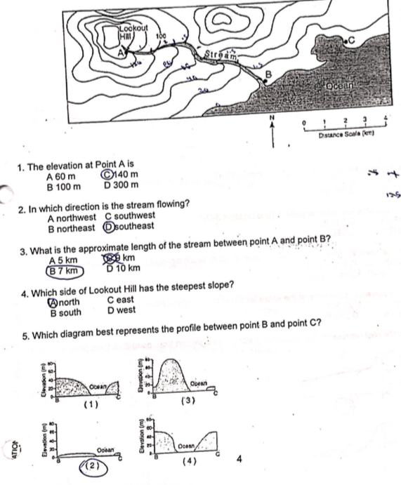

Slide 31
What should I know?!
Map Skills package
Understand scale
Understand measuring map distance and converting to real life distance
Understand directions (N,W,S,E)
Contour lines. If you understand the practice exercise from today you are GOOD!

Slide 32
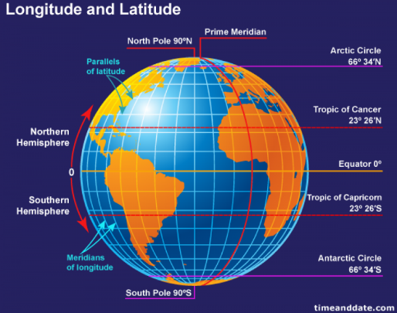
(2) Latitude and Longitude:
Important lines of latitude (equator, tropic of cancer, tropic of cancer, arctic circle, antarctic circle)
Important line of latitude of longitude (prime meridian, international date line)

Slide 33
How to give an absolute location?
Latitude first, Longitude Second
Give the Degree, then the minutes
53 30’ North, 105 45’ West

Slide 34
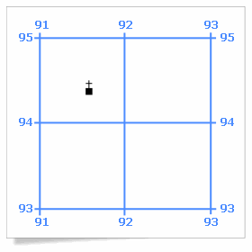
(3) Military Grid References:
Know how to give a 4 digit and 6 digit reference number
Remember: bottom number first, side number second!
Church is in square: 9194
Church 6 digit point: 916944

Slide 35
(4) 5 themes
Location (absolute/ relative)
Place (physical/ human)
Movement (goods, ideas, peoples)
Region (political, functional, vernacular)
Human-Environment Interaction (positive, negative, adaptations)
I will ask questions in relation to the city of Vancouver—so think ahead!

Slide 36
(5) 4 Spheres:
Hydrosphere (water)
Lithosphere (plates/soil)
Biosphere (all living things)
Atmosphere (atmosphere….)
I may ask about a natural disaster, a man made environment impact, negative or positive human impacts.
Understand how each of the spheres is affected.

