Slide 1
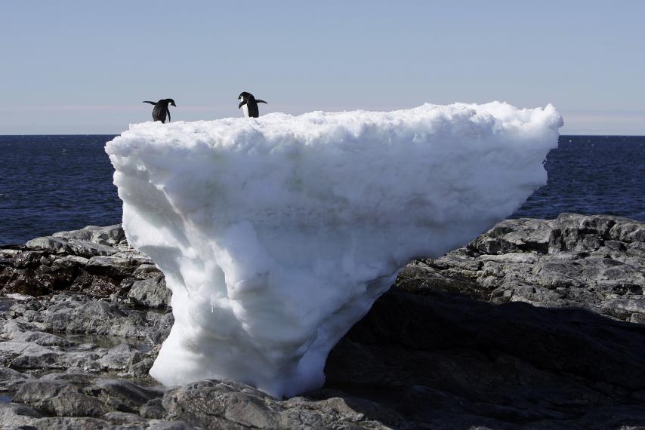
The essential science behind Climate Change – for students and teachers
Jenny Pollock
HOD Earth & Space Science
Nelson College for Girls
jenny.pollock@xtra.co.nz
July 2016
Two Adelie penguins stand atop a block of melting ice on a rocky shoreline at Cape Denison, Commonwealth Bay, in East Antarctica January 1, 2010. PAULINE ASKIN/REUTERS

Slide 2
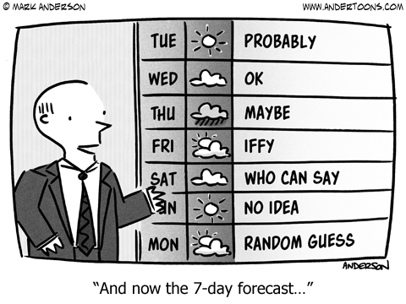
What is the difference between climate and weather?
Weather is the term we use for short-term atmospheric conditions at a particular time and place – eg cold, windy and rainy in Wellington today.
Climate is average weather for a city, country or the whole planet over years.
Put simply – climate tells you what clothes to buy but weather tells you what clothes to wear.
Climate change happens when there are changes to average weather.
Climate varies over years with natural cycles/events
(eg El Nino/La Nina cycles or volcanic eruptions)
Changes over decades to thousands of years
are caused by changes in greenhouse gases in the
atmosphere from both natural and human activity.

Slide 3
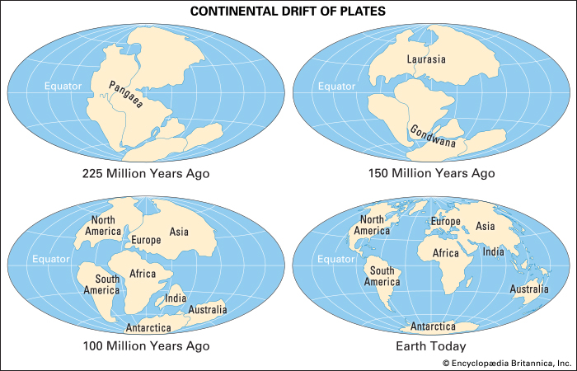
The world's climate varies naturally over millennia as a result of:
Changes in energy received from the sun
Changes in the blanket of greenhouse gases
Changes in the Earth's orbit and tilt of its
axis (affects solar energy reaching earth)
Absorption of heat by the oceans (over 90%)
Tectonic plate movement causing changes in ocean
circulation, mountain building and volcanic activity
Climate has cooled (~13°C) naturally over the last 50 million years, and varied in
100,000-year warm-cold cycles (the Ice Ages ~5°C) over the last million years.
However, there is very strong evidence that the 1°C warming of the last ~100 years can’t be explained just by natural causes. The concentration of greenhouse gases in the atmosphere has risen especially because of the burning of fossil fuels and deforestation.
Modern Climate Change is also called Global Warming, because Earth is now slowly warming.
The evidence for this comes from many sources – see slide 17.

Slide 4
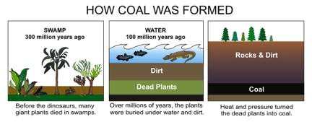
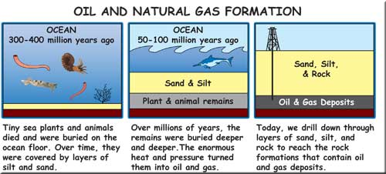
Fossil Fuels
http://tunza.eco-generation.org/editorPhoto/clip_image002_0011.jpg
Fossil fuels are the remains of once living organisms that were fossilized and changed into coal, crude oil and natural gas 10’s to 100’s of millions of years ago. Burning fossil fuels over the last decades and centuries has resulted in fossilized carbon being released into the atmosphere as carbon dioxide.
http://s18.postimg.org/x9e9fytnt/oildrill.png

Slide 5
Some of the evidence for Climate Change and Global Warming
Increasing temperatures — Global temperature averages over the last 100 years by NASA and the Hadley Centre show the Earth has warmed by about 1°C, mostly in the last four decades. Oceans have also warmed by absorbing over 90% of the sun’s heat.
Changes in rainfall — Rainfall patterns are changing across the globe with increasing floods and droughts. There are also changes between seasons in different regions.
Changes in nature — Growing seasons have lengthened with spring starting earlier and autumn/winter later. Many species are changing their behaviour and where they live.
Sea-level rise (SLR)— Sea-levels have risen about 17 cm (global average) since 1900 because of thermal expansion of ocean water and melting glacier ice. SLR has increased from ~1mm/year 100 years ago to 3 mm/year today.
Glaciers all over the world are retreating, but outside the polar regions these can add <0.5 m to SLR. The polar ice sheets (Greenland and the Antarctic) store water equivalent to 7 and 57 m of Sea Level Rise respectively, and started to lose mass in the 1990s. At present they contribute only 1mm of SLR/year, but satellite measurements show ice loss is accelerating which could raise SL ~1m by 2100.

Slide 6
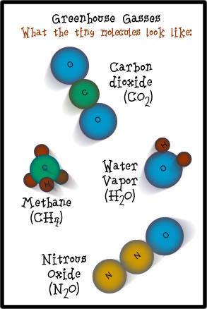
What is causing the Climate to change?
The Earth is getting warmer because humans are adding heat-trapping gases to the atmosphere, mainly by burning fossil fuels. These are called greenhouse gases(GHGs).
Which gases are greenhouse gases?
The main ones are:
Carbon dioxide: released naturally (e.g. volcanoes, decaying
plants/animals, respiration. Also from burning fossil fuels.
~76% of emissions. Persists for millennia; ~ 20% left after 10,000 years.
Methane: released naturally by decomposition in swamps, from
ruminants, especially cows, and leakage from fossil fuel extraction.
~16% of emissions. More effective than CO₂ but less abundant.
Critically, it loses its effect when it breaks down after ~10 years.
Nitrous oxide: released mainly from agricultural fertiliser.
~6% of emissions. Breaks down or absorbed after ~100 years .
Water vapour: also a GHG but water is everywhere, and warmer air
carries more vapour. Water vapour doesn’t drive but amplifies warming from other GHGs

Slide 7
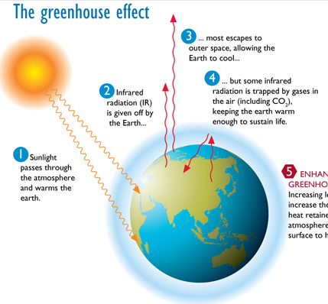
But – first of all – what is ‘normal’ or ‘natural’?
We need a certain amount of GHGs.
If it were not for greenhouse gases
(carbon dioxide, methane and nitrous
oxide) trapping heat in the
atmosphere, the Earth would be a
very cold place. Greenhouse gases
keep the Earth warm through
this greenhouse effect.
The GHGs form an invisible layer in the
troposphere – the bottom layer of the
atmosphere.
Note: It is (long wave) infrared radiation
given off by the Earth that is trapped by GHGs
(NOT solar radiation).
http://www.dpi.nsw.gov.au/content/education/resources-for-schools

Slide 8
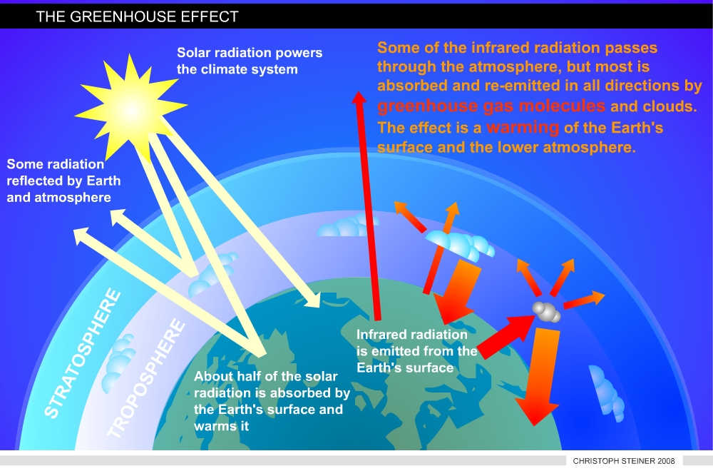
The Earth gets solar energy as sunlight (shortwave radiation). The Earth's surface absorbs some of this energy and heats up, but then cools down by giving off a different form of energy, called (longwave) infrared radiation.
Some of this radiation escapes to outer space, but most is absorbed and re-emitted by GHGs which makes the atmosphere warmer. This makes the Earth's surface warmer, too.
More on the Greenhouse Effect

Slide 9
If greenhouse gases are normal what is going wrong?
Humans are adding extra CO₂, CH₄ and nitrous oxide to the atmosphere.
Synthetic greenhouse gases are also being added such as CFCs plus sulfur compounds. (CFCs deplete ozone in the stratosphere but when they are in the troposphere they act as GHGs).
CO₂ is produced the most and it causes most of the warming. At the moment the ocean is absorbing large amounts of CO₂.
As fossil fuel usage increases (such as the burning of coal, oil and natural gas), the amount of these gases in the atmosphere rises.
Humans have interfered with the carbon cycle (e.g. by burning forest lands, or mining and burning coal), and have moved carbon from solid storage to its gaseous state, increasing atmospheric concentrations.

Slide 10
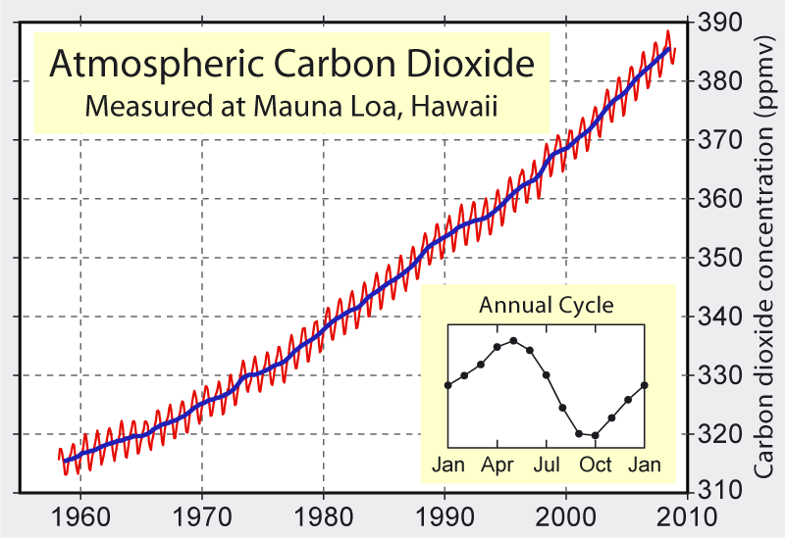
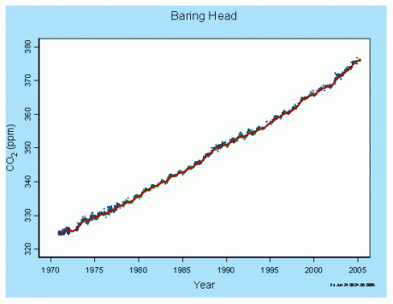
How do we know that there is extra CO₂ in the atmosphere?
The evidence for this comes from atmospheric measurements of carbon dioxide in the northern and southern hemispheres.
Amount of CO₂ in the air at Baring Head
since 1971

Slide 11
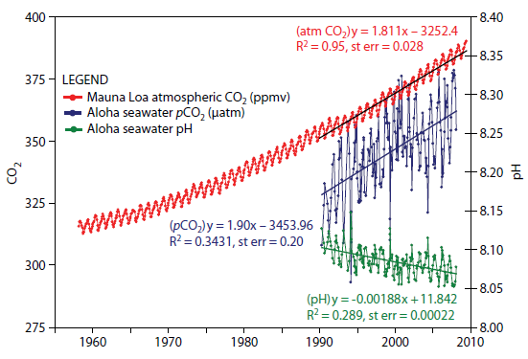
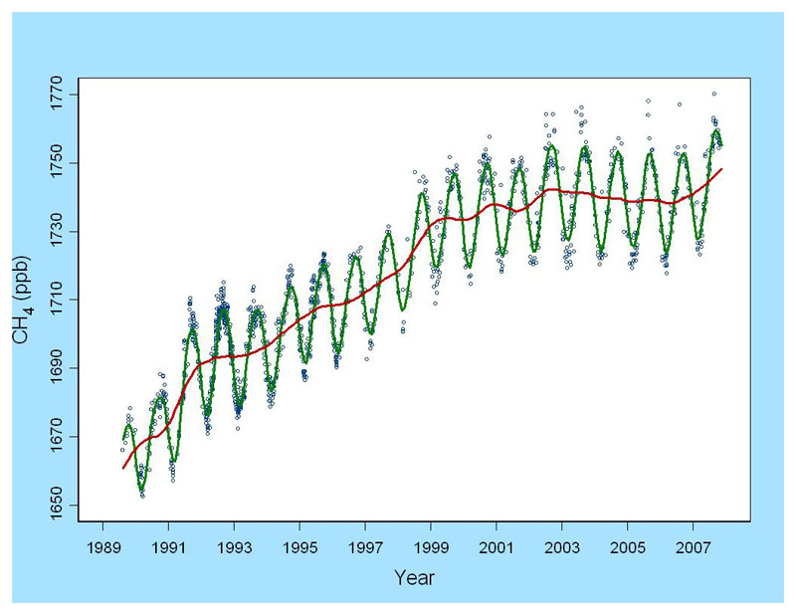
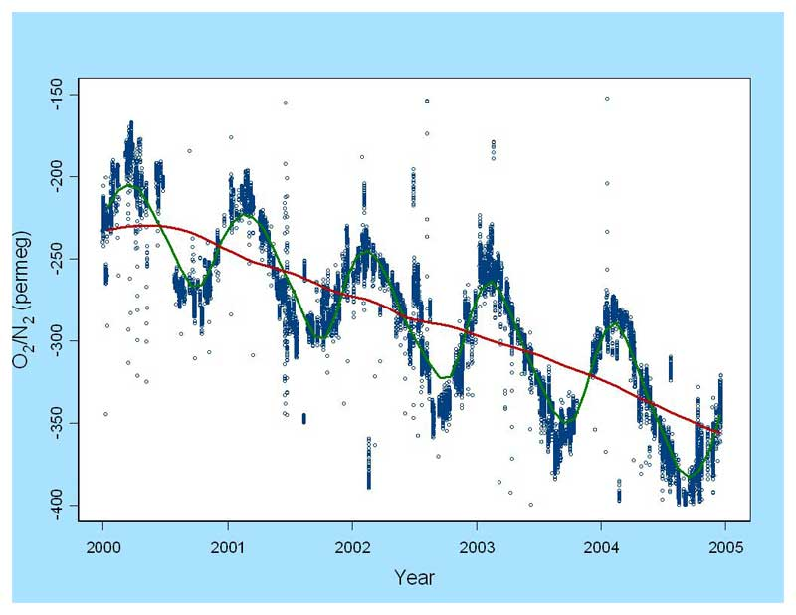
Other consequences
Graph showing rise in CO₂
plus rise of CO₂ in ocean and
the resulting reduction in pH.
The amount of oxygen in the Air at Baring Head since 1999 is decreasing – confirming that the increase is CO₂ is from burning carbon.
Amount of Methane in the Air at Baring Head since 1990

Slide 12
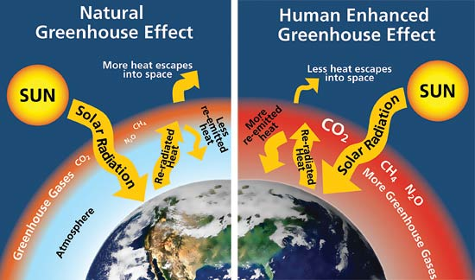
What is happening
is called the Enhanced Greenhouse Effect.
The extra GHGs result in more heat being absorbed and re-emitted to Earth’s surface, warming it.
More exactly:
http://2.bp.blogspot.com/-Ap9_Jg7n35c/VW0U5LTNFXI/AAAAAAAAA5g/Z46jceXDS7Q/s1600/Greenhouse-effect.jpg
The increased greenhouse gases in the atmosphere increases its “effective radiating level” (ERL). Since the fall in temperature with increasing height in the atmosphere is constant (~6°C/km), and the temperature at the ERL is constant (-18°C), the temperature at the surface of the earth rises as greenhouse gases increase. This is called the “enhanced greenhouse effect”.

Slide 13
GHGs from humans From 1970 to 2010.
IPCC AR5 WG1 2014 Figure SPM.1
There is now a global effort to reverse this rising trend - the Paris Agreement on Climate Change, signed in New York on 22 April 2016.
Its aim is “Holding the increase in the global average temperature to well below 2 °C above pre-industrial levels, and pursuing efforts to limit the temperature increase to 1.5 °C above pre-industrial levels..”,
https://en.wikipedia.org/wiki/Paris_Agreement

Slide 14
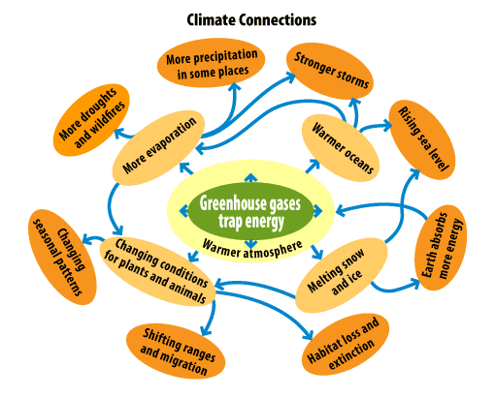
Climate change effects are interrelated and are very hard to exactly work out. This can lead to some people denying that there is such a thing as Climate change or Global warming.
https://www.youtube.com/watch?v=cjuGCJJUGsg watch this
John Oliver clip.

Slide 15
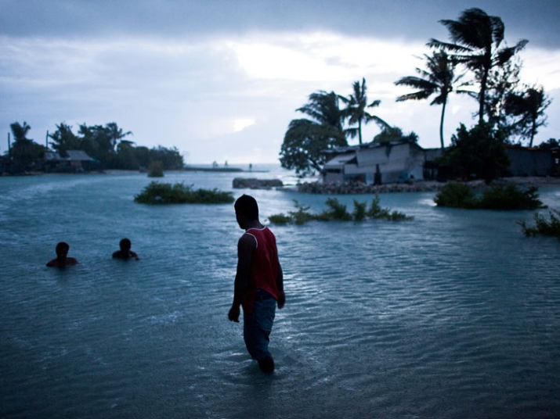
Why are sea levels rising?
The two major causes are:
thermal expansion caused by the warming of the oceans (since water expands as it warms)
the loss of land-based ice (such as glaciers and ice sheets) due to increased melting
Thermal expansion:
When water heats up, it expands. This means
that the warmer oceans occupy more space.
Sea ice melting:
This doesn’t make the sea level rise. This is because it’s already floating in the ocean. Take a glass of ice water. As it warms, the ice in the glass melts, but the total volume of water does not change.
http://i.telegraph.co.uk/multimedia/archive/02822/001-KIRIBATI_2822394k.jpg

Slide 16
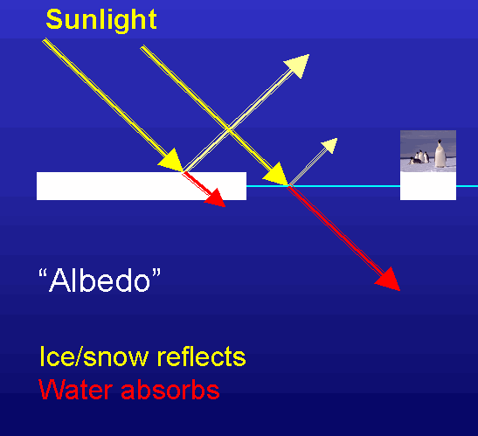
Albedo is the measure of the reflectivity of a surface
A perfectly white reflecting surface has an albedo of 1
A perfectly black absorbing surface has an albedo of 0
A surface looks bright when it reflects most of the light that hits it e.g. ice sheets, deserts, some rocks e.g. limestone.
A surface looks dark when most of the light is absorbed e.g. ocean, dark surfaces.
The Sun’s energy is reflected off ice and back out into space. If ice melts the solar energy is absorbed by the earth and ocean surface instead, warming them up further.

Slide 17
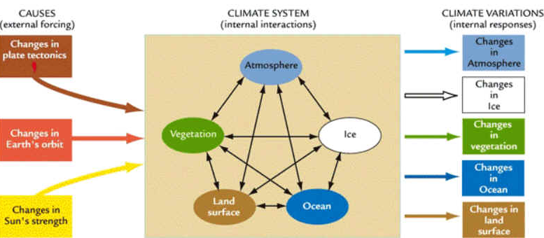
The climate system is influenced by many factors, making it complicated to understand and difficult to work out exactly what might happen.
Feedbacks in
the climate
system happen
when these
factors affect
each other.
Positive feedbacks increase temperature
Negative feedbacks decrease temperature
Climate scientists also gain evidence of the
effects of change by looking back into the past

Slide 18
Earth’s climate has changed before; evidence comes from many sources:
Ice cores: Ratio of O₂ and C isotopes in ice shows temperature changes; air
bubbles can be analysed to measure past CO₂ and CH₄ concentrations.
Fossil Pollen: Different plants produce distinctive pollen grains which can be preserved in sediment cores from ponds, lakes and oceans.
Lake sediments: Composition and sedimentation rates change in response to environmental conditions. Pollen and phytoplankton show the physical and chemical conditions of lake water.
Ocean sediment cores: contain plankton whose abundance depends on surface water temperature and other conditions such as pH.
Wind borne material: Its accumulation at a particular location can provide information on past windiness and dryness.
Glaciers: Variations in the past size of glaciers can be inferred from rocks and debris, buried soils and glacial features in the landscape.
Tree ring width: depends on soil moisture, temperature and other growing conditions and can be used to reconstruct past climates.
Instrument Measurements and written or oral records: NZ only has 150 years of temperature and other meteorological records. Such records can identify the influence of any non-climate factors (such as encroaching urban development).

Slide 19
Depletion of the Ozone layer vs Climate Change
These two issues can become very confused in some people’s minds.
Depletion of ozone layer (ozone hole)
The ozone layer is in the stratosphere.
This ozone is created when high-energy
UV strikes an oxygen molecule – a
natural process.
Ozone protects us from UV radiation
Depletion of ozone (the ozone hole) was caused by long-living chemicals, CFCs, that humans released into the atmosphere.
International agreements such as the Montreal Protocol have banned the use
of CFCs.
There is a good chance that the ozone hole will mend in the near future
This is a relatively straightforward issue
Climate Change (CC) or Global warming
Greenhouse gases (GHG) e.g. CO₂ are found in the troposphere.
GHGs are important for keeping Earth warm because they form an invisible layer that traps heat that is radiating away from Earth.
But extra GHGs are accumulating in the atmosphere because of human activity.
So extra heat is being trapped, warming the surface of the Earth.
The climate system is affected by many factors which makes the issue very complex e.g. the Earth is warming but some parts are getting colder
CC can not be easily fixed.

Slide 20
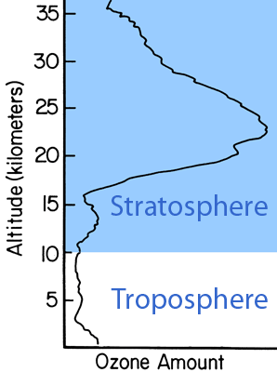
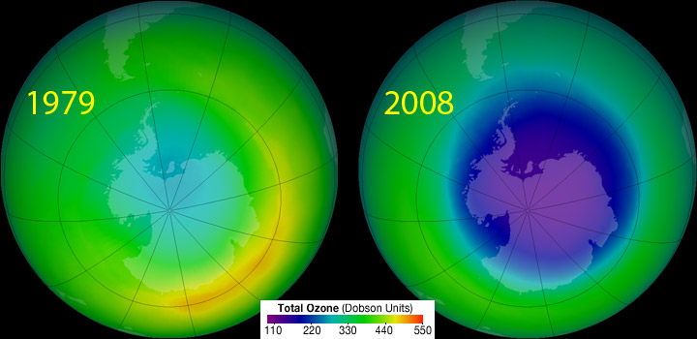
The ozone layer is a region within the stratosphere
with a high concentration of ozone - generally
between 2 and 8 ppm.
Ozone is created when high-energy UV strikes a normal oxygen molecule.
Ozone in the stratosphere protects us from UV in sunlight by absorbing most of the incoming UV before it reaches the ground. It re-radiates the energy as heat, warming the stratosphere.
The Ozone Hole is a major "thinning" of the
ozone layer in the atmosphere. The hole
appears in the winter over the poles,
especially the South Pole. Certain long-living chemicals that humans released into the
atmosphere, such as CFCs, destroyed ozone by chemical reactions.
International agreements have banned the use of CFCs which is helping mend the hole.

Slide 21
Great sites to visit:
http://thiniceclimate.org/free-resources
https://www3.epa.gov/climatechange/kids/index.html
https://www.niwa.co.nz/education-and-training/schools/students/climate-change-global-warming-and-greenhouse-gases
https://vimeo.com/119312940 Fox Glacier’s spectacular retreat in recent years
Also see two reports from the Royal Society of NZ on Climate implications for NZ, and A Low Carbon Future for NZ, summarising our situation and what we can do, at:
http://www.royalsociety.org.nz/expert-advice/papers/yr2016

